Slide 1


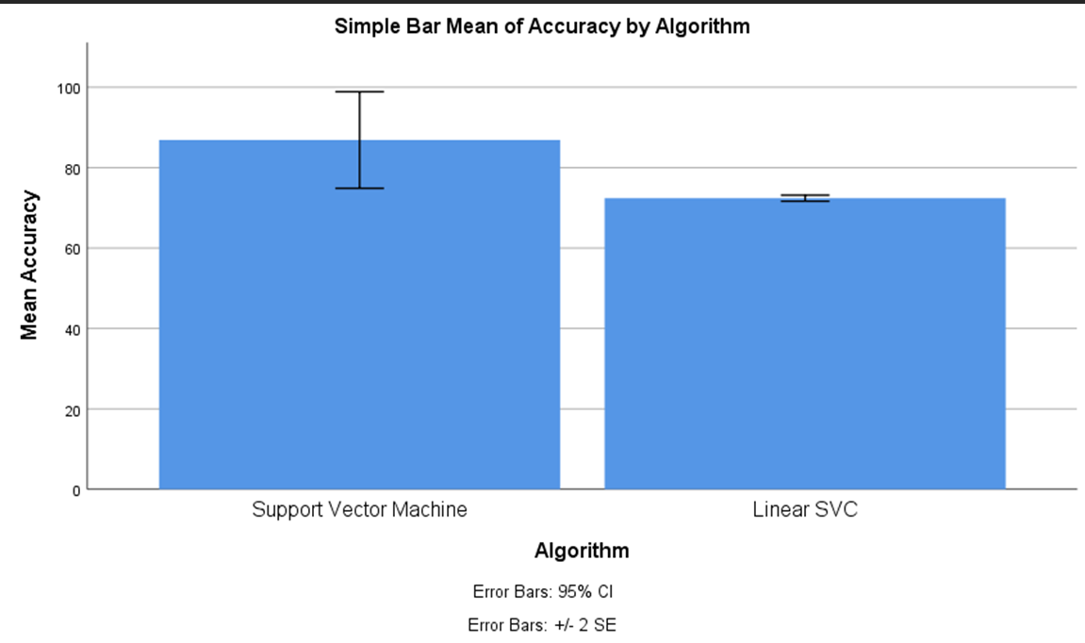
Name: Varun Kumar Register Number:192110128
Guided by: Dr. J.Joslin Jeya Sheela
Ms. Poorani.S
Guided by Dr. Mary Valantina. G
A Meta Classifier Model for Dispatch Spyware Discernment Using Support Vector Machines (SVM) Comparing With Linear SVC Algorithm
INTRODUCTION
The aim of the study "A Meta Classifier Model for Dispatch Spyware Discernment Using Support Vector Machines (SVM) Comparing With Linear SVC Algorithm" is to evaluate and compare the effectiveness.
The importance of a meta-classifier model for dispatch spyware discernment using Support Vector Machines (SVM) compared with Linear SVC algorithm lies in its potential to enhance the accuracy and reliability of spyware detection systems.
The application of a meta-classifier model for dispatch spyware discernment utilizing Support Vector Machines (SVM) compared with Linear SVC algorithm offers several practical implications. Firstly, in the realm of cybersecurity, where identifying and mitigating spyware threats.
SVM can effectively classify data points into different categories; Linear SVC demonstrates efficiency in processing high-dimensional data with linear separability.
The data set contains the Labeling , Data Processing , Serves as the primary dataset for testing and training.
MATERIALS AND METHODS
Model Development
(SVM)
Data Collection
Data Preprocessing and Feature Extraction
Comparison Analysis and Statistical Testing
Output
Spyware Detection
Model Development
(Linear SVC)
RESULTS
Group Statistics
Independent Samples Test
 | Algorithm | N | Mean | Std.Deviation | Std.Error Mean
Accuracy | Support vector machine | 15 | 91.93 | 23.237 | 6.00
 | Linear SVC | 15 | 72.40 | 1.454 | .375
 | Levene’Test |  | T-Test For Equality Of Means
 | F | Sig | t | df | Sig(2-tailed) | Mean difference | StdError | 95% Confidence
 |  |  |  |  |  |  |  | lower | upper
Equal Variances | 3.657 | .066 | 2.406 | 28 | .023 | 14.467 | 6.012 | 2.152 | 26.781
No Equal Variances |  |  | 2.406 | 14.110 | .030 | 14.467 | 6.012 | 1.582 | 27.351
Statistical Analysis values of Mean accuracy (91.93), Standard Deviation(1.335), and Standard error deviation. The Support Vector Machine Algorithm and the Linerar SVC algorithm have the values of the Mean accuracy, Standard Deviation, and Standard Error.
Comparison of Significance Level with value p<0.05. Both Support Vector Machine Algorithm and the Linear SV Algorithm have a confidence interval of 95% with the significance value 0.000( p<0.05).
DISCUSSION AND CONCLUSION
According to the investigation findings, the Support vector Machine ( SVM ) outshone the Consistent Linear SVC algorithm with elevated precision of 93.68%.
The futuring effects of meta-classifier models for dispatch spyware discernment using SVM compared with Linear SVC algorithm hold the promise of enhancing cybersecurity measures, reducing false positives, adapting to evolving threats.
Several limitations may be associated with the implementation of a meta-classifier model for dispatch spyware discernment using Support Vector Machines (SVM) compared with the Linear SVC algorithm are data Imbalance, Feature Selection Bias, Limited Generalization.
The comparative analysis revealed nuanced performance differences between the two classification approaches. While both SVM and Linear SVC showed promise in accurately identifying dispatch spyware instances.
BIBLIOGRAPHY
Almousa, May, Sai Basavaraju, and Mohd Anwar. 2024. “API-Based Ransomware Detection Using Machine Learning-Based Threat Detection Models.” Accessed March 7, 2024.
Araújo, Domingos, Joaquim Silva, Patrícia Leite, Óscar Ribeiro, and Paulo Teixeira. 2024. “Predict Malware Using Machine Learning.” Accessed March 7, 2024.
Ayub, Md Ahsan, Andrea Continella, and Ambareen Siraj. 2024. “An I/O Request Packet (IRP) Driven Effective Ransomware Detection Scheme Using Artificial Neural Network.” Accessed March 7, 2024.
Swastika, Nanditha Bhandary, R. S. Shalaka, Prasad Honnavalli, and E. Sivaraman. 2024. “An Enhanced Malware Detection Approach Using Machine Learning and Feature Selection.
Jha, Anushka, Rajesh Bahuguna, Samta Kathuria, G. Sunil, Manish Gupta, and Vikrant Pachouri. 2024. “Role of AI in Combating Cyber Terrorism.” Accessed March 7, 2024.
Kimmell, Jeffrey C., Mahmoud Abdelsalam, and Mayank Gupta. 2024. “Analyzing Machine Learning Approaches for Online Malware Detection in Cloud.” Accessed March 7, 2024.

